Slide 1
EMOTION DRIVEN PLAYLIST GENERATOR
PRESENTED BY : A.GAYATHRI
REG NO : 813821205012
DEPT : INFORMATION TECHNOLOGY
COLLEGE : SARANATHAN COLLEGE OF ENGINEERING
NM ID : gaayathriangel@gmail.com
(au813821205012)
3/21/2024 Annual Review

Slide 2

PROJECT TITLE
EMOTION DRIVEN PLAYLIST GENERATOR
3/21/2024 Annual Review

Slide 3


AGENDA
1.PROBLEM STATEMENT
2.PROJECT OVERVIEW
3.WHO ARE THE END USERS?
4.YOUR VALUE AND ITS VALUE PROPOSITION
5.THE WOW IN THE SOLUTION
6.MODELLING
7.RESULTS
3/21/2024 Annual Review

Slide 4

PROBLEM STATEMENT
The Need for an Emotion Driven Playlist Generator
Users often struggle to find the right music to match their mood or emotions.
Existing playlist generators do not prioritize emotional connection and fail to provide personalized recommendations.
There is a demand for a playlist generator that can curate playlists based on the user's mood or emotions, providing a tailored music experience.
This project aims to develop an intelligent system capable of interpreting users' emotional cues and curating playlists that resonate with their feelings, thereby enhancing their music listening experience.
3/21/2024 Annual Review

Slide 5

PROJECT OVERVIEW
Overview
The Emotion Driven Playlist Generator is a project that aims to create personalized playlists based on the user's emotions. By analyzing the user's facial expressions and voice, the system can identify the user's current emotional state and curate a playlist that matches their mood.
Goals
Develop an emotion-driven playlist generator
Provide personalized music recommendations based on user's emotions
How it Works
The system uses facial recognition technology and voice analysis to detect the user's emotions. It captures the user's facial expressions and analyzes the tone and pitch of their voice to determine their emotional state. Based on the detected emotions, the system selects songs from a database that match the user's mood.
Objectives
Utilize machine learning algorithms to analyze user's facial expressions and detect emotions
Curate playlists based on the detected emotions
Enhance user experience and emotional well-being through music
3/21/2024 Annual Review

Slide 6

WHO ARE THE END USERS?
The target audience for the emotion driven playlist generator are music enthusiasts who want to curate playlists that match their mood and emotions. These users have a need for a personalized music experience that can enhance their emotional state and provide a soundtrack for different activities and situations.
Music enthusiasts: People who enjoy listening to music regularly and are looking for a more personalized and engaging listening experience.
Individuals seeking mood regulation: Those who use music as a means of managing their emotions and mood states, such as relaxation, motivation, or stress relief.
Music therapy practitioners: Professionals who incorporate music into therapeutic interventions and could benefit from a tool that assists in selecting appropriate music based on clients' emotional needs.
Streaming platforms: Companies offering music streaming services could integrate this technology into their platforms to enhance user experience and increase user engagement.
Event organizers: Individuals or organizations planning events where music plays a significant role, such as parties, weddings, or workout classes, could use this tool to create playlists tailored to the desired mood or atmosphere.
3/21/2024 Annual Review

Slide 7

YOUR SOLUTION AND ITS VALUE PROPOSITION
Emotion Driven Playlist Generator
Our solution is an emotion driven playlist generator that uses advanced AI algorithms to curate personalized playlists based on the user's current mood and emotions.
Unique Value Proposition
Personalized Music Experience: Our playlist generator creates customized playlists that perfectly match the user's emotions, providing a unique and tailored music experience.
Advanced AI Algorithms: Our solution utilizes state-of-the-art AI algorithms to analyze the user's emotions and preferences, ensuring accurate and relevant playlist recommendations.
Seamless Integration: Our playlist generator seamlessly integrates with popular music streaming platforms, allowing users to easily access and enjoy their personalized playlists.
3/21/2024 Annual Review

Slide 8

THE WOW IN YOUR SOLUTION
Highlight the unique features or aspects of your solution that make it stand out from competitors.
Personalized playlists based on user's emotions and preferences.
Advanced machine learning algorithms that analyze user's listening history to curate the perfect playlist.
Integration with popular music streaming platforms for seamless listening experience.
3/21/2024 Annual Review
8

Slide 9
MODELLING
The emotion driven playlist generator uses a machine learning model to classify songs based on their emotional characteristics. The modeling process involves the following steps:
Data Collection: Gather a large dataset of songs with labeled emotional attributes.
Feature Extraction: Extract relevant features from the audio data, such as tempo, energy, and valence.
Data Preprocessing: Normalize the features and split the dataset into training and testing sets.
Model Selection: Choose an appropriate machine learning algorithm, such as a decision tree or neural network.
Model Training: Train the selected model using the training dataset.
Model Evaluation: Evaluate the performance of the trained model using the testing dataset.
Hyperparameter Tuning: Fine-tune the model's hyperparameters to improve its performance.
Deployment: Deploy the trained model to the playlist generator application for real-time song classification and playlist generation.
3/21/2024 Annual Review
9

Slide 10
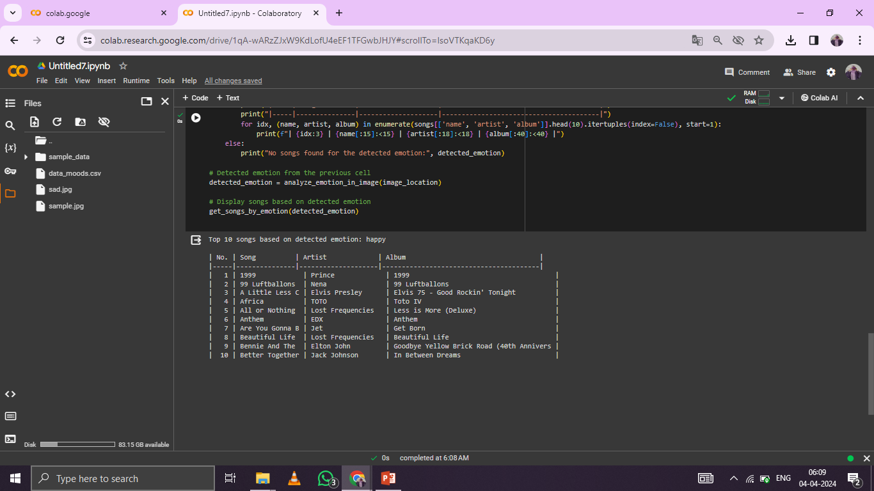
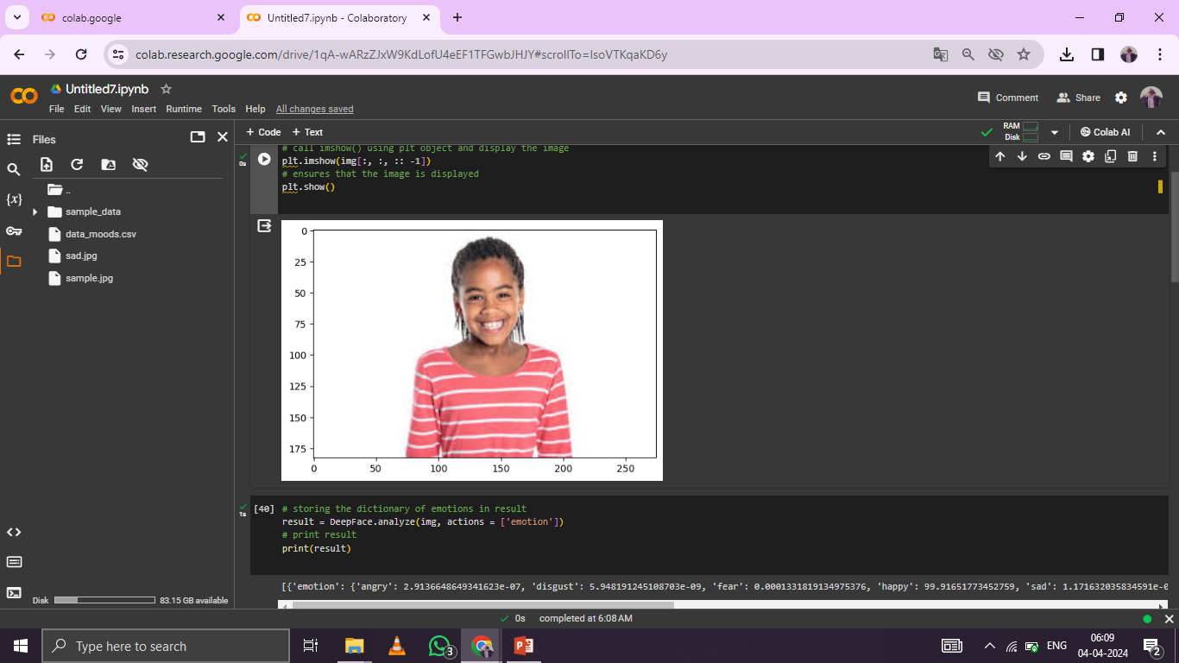
RESULTS
https://github.com/GayathriAnbuselvan/TNSDC-Generative-AI
3/21/2024 Annual Review
10

